Slide 1
CS 570: Data Structures
Computational Complexity

Slide 2
Data structure
Data structure
a way to store and organize data in order to facilitate access
and modiﬁcation.
no single data structure optimal for all purposes.
usually optimized for a speciﬁc problem setting.
important to know the strength and limitations of several of
them.
Examples:
Trees (binary search trees, red-black trees, b-trees, ...).
Stacks (last in, ﬁrst out), queues (ﬁrst in, ﬁrst out), priority
queues.

Slide 3
Algorithms
Algorithms:
well-deﬁned computational procedure.
takes value or set of values as input.
produces value or set of values as output.
tool for solving a well-speciﬁed computational problem.
instance of a problem consists of the input needed to
compute a solution to the problem.
correct algorithm solves the given computational problem.
Sorting problem:
Input: A sequence of n numbers a1,...,an .
Output: A permutation a1,...,an of the input sequence
such that a1 ≤ ··· ≤ an.

Slide 4
Eﬃciency
Computing time and memory are bounded resources.
Eﬃciency:
Diﬀerent algorithms that solve the same problem often diﬀer
in their eﬃciency.
More signiﬁcant than diﬀerences due to hardware (CPU,
memory, disks, ...) and software (OS, programming language,
compiler, ...).
Example:
Insertion sort (c₁n²) vs. merge sort (c₂nlgn).

Slide 5
Asymptotic Performance
In this course, we care most about asymptotic performance
How does the algorithm behave as the problem size gets very large?
Running time
Memory/storage requirements
Bandwidth/power requirements/logic gates/etc.
Notes:
A method of describing limiting behavior.

Slide 6
Asymptotic Notation
By now you should have an intuitive feel for asymptotic (big-O) notation:
What does O(n) running time mean? O(n²)? O(n lg n)?
How does asymptotic running time relate to asymptotic memory usage?
Our first task is to define this notation more formally and completely

Slide 7
Input Size
Time and space complexity
This is generally a function of the input size
E.g., sorting, multiplication
How we characterize input size depends:
Sorting: number of input items
Multiplication: total number of bits
Graph algorithms: number of nodes & edges
Etc

Slide 8
Running Time
Number of primitive steps that are executed
Except for time of executing a function call most statements roughly require the same amount of time
y = m * x + b
c = 5 / 9 * (t - 32 )
z = f(x) + g(y)
We can be more exact if need be
Worst case vs. average case

Slide 9
Algorithm Efficiency and Big-O

Slide 10
Algorithm Efficiency and Big-O
Getting a precise measure of the performance of an algorithm is difficult
Big-O notation expresses the performance of an algorithm as a function of the number of items to be processed
This permits algorithms to be compared for efficiency
For more than a certain number of data items, some problems cannot be solved by any computer

Slide 11
Linear Growth Rate
If processing time increases in proportion to the number of inputs n, the algorithm grows at a linear rate
public static int search(int[] x, int target) {
for(int i=0; i<x.length; i++) {
if (x[i]==target)
return i;
}
return -1; // target not found
}

Slide 12
Linear Growth Rate
If the target is not present, the for loop will execute x.length times
If the target is present the for loop will execute (on average) (x.length + 1)/2 times
Therefore, the total execution time is directly proportional to x.length
This is described as a growth rate of order n OR O(n)
If processing time increases in proportion to the number of inputs n, the algorithm grows at a linear rate
public static int search(int[] x, int target) {
for(int i=0; i<x.length; i++) {
if (x[i]==target)
return i;
}
return -1; // target not found
}

Slide 13
n x m Growth Rate
Processing time can be dependent on two different inputs
public static boolean areDifferent(int[] x, int[] y) {
for(int i=0; i<x.length; i++) {
if (search(y, x[i]) != -1)
return false;
}
return true;
}

Slide 14
n x m Growth Rate (cont.)
The for loop will execute x.length times
But it will call search, which will execute y.length times
The total execution time is proportional to (x.length * y.length)
The growth rate has an order of n x m or O(n x m)
Processing time can be dependent on two different inputs.
public static boolean areDifferent(int[] x, int[] y) {
for(int i=0; i<x.length; i++) {
if (search(y, x[i]) != -1)
return false;
}
return true;
}

Slide 15
Quadratic Growth Rate
If processing time is proportional to the square of the number of inputs n, the algorithm grows at a quadratic rate
public static boolean areUnique(int[] x) {
for(int i=0; i<x.length; i++) {
for(int j=0; j<x.length; j++) {
if (i != j && x[i] == x[j])
return false;
}
}
return true;
}

Slide 16
Quadratic Growth Rate (cont.)
The for loop with i as index will execute x.length times
The for loop with j as index will execute x.length times
The total number of times the inner loop will execute is (x.length)²
The growth rate has an order of n² or O(n²)
If processing time is proportional to the square of the number of inputs n, the algorithm grows at a quadratic rate
public static boolean areUnique(int[] x) {
for(int i=0; i<x.length; i++) {
for(int j=0; j<x.length; j++) {
if (i != j && x[i] == x[j])
return false;
}
}
return true;
}

Slide 17
Big-O Notation
The O() in the previous examples can be thought of as an abbreviation of "order of magnitude"
A simple way to determine the big-O notation of an algorithm is to look at the loops and to see whether the loops are nested
Assuming a loop body consists only of simple statements,
a single loop is O(n)
a pair of nested loops is O(n²)
a nested pair of loops inside another is O(n³)
and so on . . .

Slide 18
Big-O Notation (cont.)
You must also examine the number of times a loop is executed
for(i=1; i < x.length; i *= 2) {
// Do something with x[i]
}
The loop body will execute k-1 times, with i having the following values: 1, 2, 4, 8, 16, . . ., 2^{k} until 2^{k} is greater than x.length
Since 2^{k-1} = x.length < 2^{k} and log₂2^{k} is k, we know that k-1 = log₂(x.length) < k
Thus we say the loop is O(log n) (in analyzing algorithms, we use logarithms to the base 2)
Logarithmic functions grow slowly as the number of data items n increases

Slide 19
Formal Definition of Big-O
Consider the following program structure:
for (int i = 0; i < n; i++) {
for (int j = 0; j < n; j++) {
Simple Statement
}
}
for (int i = 0; i < n; i++) {
Simple Statement 1
Simple Statement 2
Simple Statement 3
Simple Statement 4
Simple Statement 5
}
Simple Statement 6
Simple Statement 7
...
Simple Statement 30

Slide 20
Formal Definition of Big-O (cont.)
Consider the following program structure:
for (int i = 0; i < n; i++) {
for (int j = 0; j < n; j++) {
Simple Statement
}
}
for (int i = 0; i < n; i++) {
Simple Statement 1
Simple Statement 2
Simple Statement 3
Simple Statement 4
Simple Statement 5
}
Simple Statement 6
Simple Statement 7
...
Simple Statement 30
This nested loop executes a Simple Statement n² times

Slide 21
Formal Definition of Big-O (cont.)
Consider the following program structure:
for (int i = 0; i < n; i++) {
for (int j = 0; j < n; j++) {
Simple Statement
}
}
for (int i = 0; i < n; i++) {
Simple Statement 1
Simple Statement 2
Simple Statement 3
Simple Statement 4
Simple Statement 5
}
Simple Statement 6
Simple Statement 7
...
Simple Statement 30
This loop executes 5 Simple Statements n times (5n)

Slide 22
Formal Definition of Big-O (cont.)
Consider the following program structure:
for (int i = 0; i < n; i++) {
for (int j = 0; j < n; j++) {
Simple Statement
}
}
for (int i = 0; i < n; i++) {
Simple Statement 1
Simple Statement 2
Simple Statement 3
Simple Statement 4
Simple Statement 5
}
Simple Statement 6
Simple Statement 7
...
Simple Statement 30
Finally, 25 Simple Statements are executed

Slide 23
Formal Definition of Big-O (cont.)
Consider the following program structure:
for (int i = 0; i < n; i++) {
for (int j = 0; j < n; j++) {
Simple Statement
}
}
for (int i = 0; i < n; i++) {
Simple Statement 1
Simple Statement 2
Simple Statement 3
Simple Statement 4
Simple Statement 5
}
Simple Statement 6
Simple Statement 7
...
Simple Statement 30
We can conclude that the relationship between processing time and n (the number of date items processed) is:
T(n) = n² + 5n + 25

Slide 24
Formal Definition of Big-O (cont.)
In terms of T(n),
T(n) = O(f(n))
means that there exist
two constants, n₀ and c, greater than zero, and
a function, f(n),
such that for all n > n₀, cf(n) >= T(n)
In other words, as n gets sufficiently large (larger than n₀), there is some constant c for which the processing time will always be less than or equal to cf(n)
cf(n) is an upper bound on performance

Slide 25
Formal Definition of Big-O (cont.)
The growth rate of f(n) will be determined by the fastest growing term, which is the one with the largest exponent
In the example, an algorithm of
O(n² + 5n + 25)
is more simply expressed as
O(n²)
In general, it is safe to ignore all constants and to drop the lower-order terms when determining the order of magnitude

Slide 26
Big-O Example 1
Given T(n) = n² + 5n + 25, show that this is O(n²)
Find constants n₀ and c so that, for all n > n₀, cn² > n² + 5n + 25
Find the point where cn² = n² + 5n + 25
Let n = n₀, and solve for c
c = 1 + 5/ n₀ + 25/ n₀ ²
When n₀ is 5, the RHS is (1 + 5/5 + 25/25), c is 3
So, 3n² > n² + 5n + 25 for all n > 5
Other values of n₀ and c also work

Slide 27
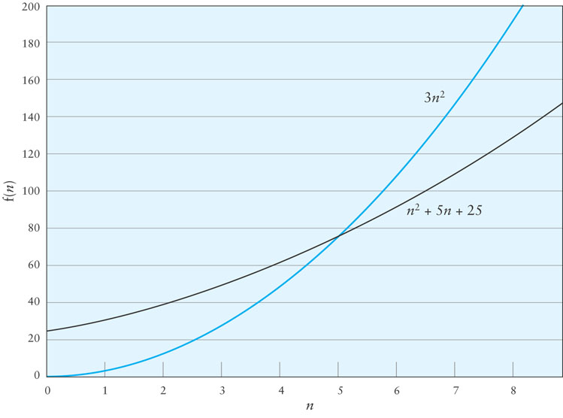
Big-O Example 1 (cont.)

Slide 28
Big-O Example 2
Consider the following loop
for (int i = 0; i < n; i++) {
for (int j = i + 1; j < n; j++) {
3 simple statements
}
}
T(n) = 3(n – 1) + 3 (n – 2) + … + 3
Factoring out the 3,
3(n – 1 + n – 2 + … + 1)
1 + 2 + … + n – 1 = (n x (n-1))/2

Slide 29
Big-O Example 2 (cont.)
Therefore T(n) = 1.5n² – 1.5n
When n = 1, the polynomial has value 0
For values of n > 1, 1.5n² > 1.5n² – 1.5n
Therefore T(n) is O(n²) when n₀ is 1 and c is 1.5

Slide 30
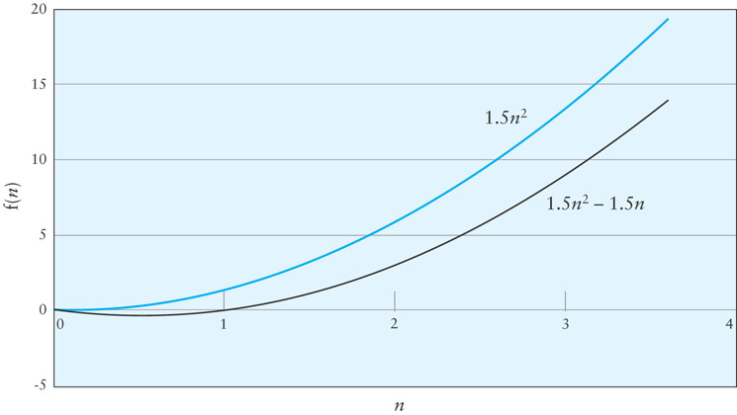
Big-O Example 2 (cont.)

Slide 31
Big-O of polynomials
Suppose runtime is an² + bn + c
If any of a, b, and c are less than 0 replace the constant with its absolute value
an² + bn + c ≤ (a + b + c)n² + (a + b + c)n + (a + b + c)
≤ 3(a + b + c)n² for n ≥ 1
Let c’ = 3(a + b + c) and let n₀ = 1

Slide 32
Big-O of polynomials
A polynomial of degree k is O(n^{k})
Proof:
Suppose f(n) = b_{k}n^{k} + b_{k-1}n^{k-1} + … + b₁n + b₀
Let a_{i} = | b_{i} |
f(n) ≤ a_{k}n^{k} + a_{k-1}n^{k-1} + … + a₁n + a₀

Slide 33
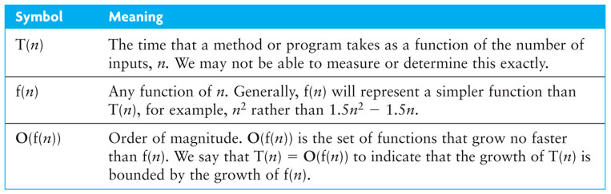
Symbols Used in Quantifying Performance

Slide 34
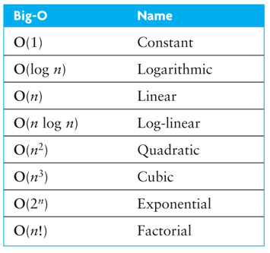
Common Growth Rates
Notes:
exponential: break a binary password of length n (brute force)
factorial: traveling salesman problem

Slide 35
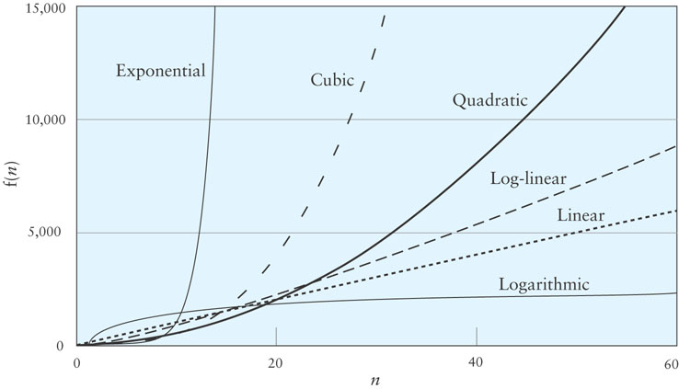
Different Growth Rates

Slide 36
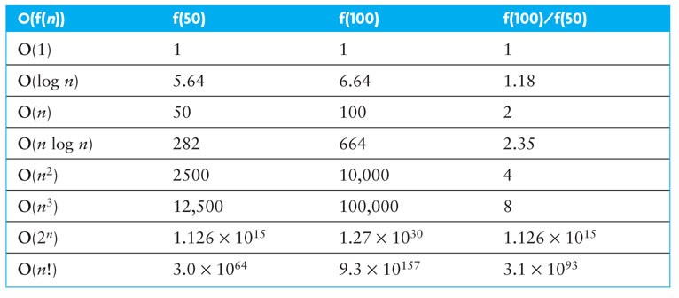
Effects of Different Growth Rates

Slide 37
Algorithms with Exponential and Factorial Growth Rates
Algorithms with exponential and factorial growth rates have an effective practical limit on the size of the problem they can be used to solve
With an O(2^{n}) algorithm, if 100 inputs takes an hour then,
101 inputs will take 2 hours
105 inputs will take 32 hours
114 inputs will take 16,384 hours (almost 2 years!)

Slide 38
Algorithms with Exponential and Factorial Growth Rates (cont.)
Encryption algorithms take advantage of this characteristic
Some cryptographic algorithms can be broken in O(2^{n}) time, where n is the number of bits in the key
A key length of 40 is considered breakable by a modern computer,
but a key length of 100 bits will take a billion-billion (10¹⁸) times longer than a key length of 40
Notes:
Quintillion

